Slide 1
Ridge Regression
Shiv Bhutani

Slide 2
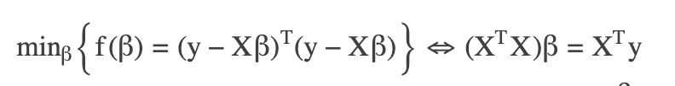
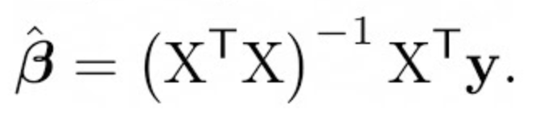
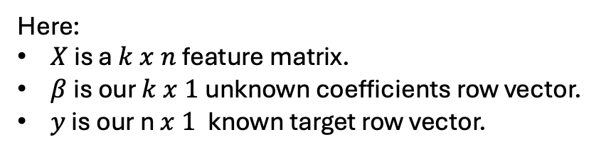
Ordinary Multiple Linear Regression
Here:
$X$ is a $k x n$feature matrix.
$β$is our $k x 1$unknown coefficients row vector.
$y$ is our n$x 1$known target row vector.

Slide 3
Benefits and Drawbacks of Ordinary Linear Regression
Advantages:
Simple and interpretable model.
Works well when there is a linear relationship and no multicollinearity.
Disadvantages:
Overfitting: Can overfit when there are too many features or limited data.
Multicollinearity: Leads to unstable coefficient estimates.

Slide 4
Multicollinearity
Definition:
Multicollinearity occurs when two or more independent variables (predictors) in a regression model are highly correlated.
Example in housing pricing
House Size (in square feet) and Number of Bedrooms are often highly correlated.
Both variables tend to increase together, which introduces redundant information into the model.

Slide 5
Multicollinearity: Why It's a Problem in Housing Price Prediction
Overfitting: A Risk in Housing Price Models
What is Overfitting?
Overfitting occurs when the model becomes too complex, capturing the noise in the training data rather than the underlying pattern.
This leads to excellent performance on the training set but poor generalization to new, unseen data. Cross-Validation yields poor results.
Why Multicollinearity Contributes to Overfitting:
When variables are highly correlated, the model may give undue importance to noisy or redundant features.

Slide 6
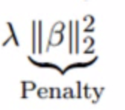
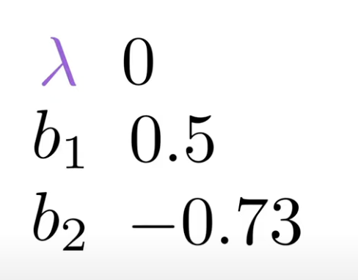
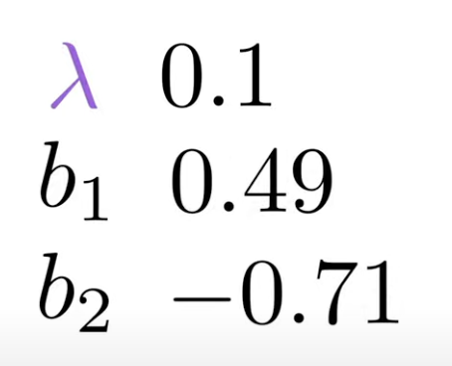
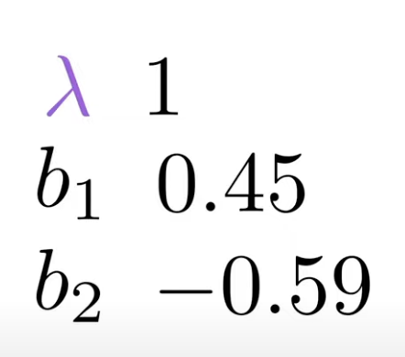
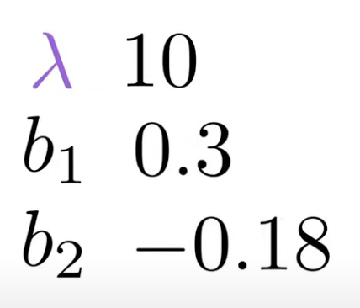
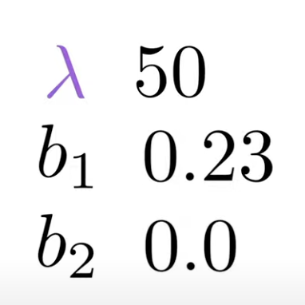
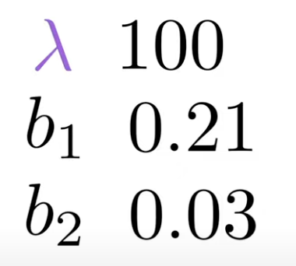
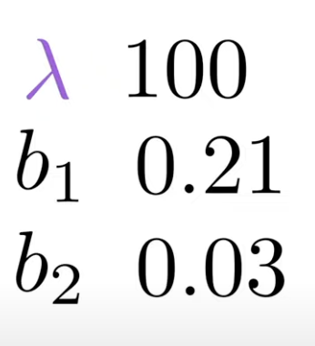
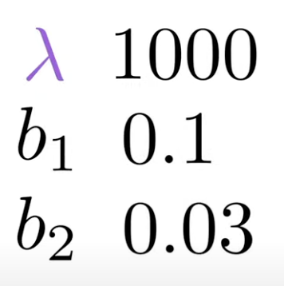
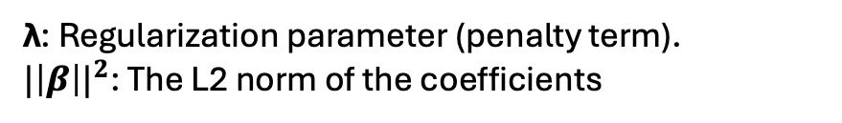
Ridge Penalty :
λ: Regularization parameter (penalty term).
${|\left|β\right||}^{2}$: The L2 norm of the coefficients

Slide 7
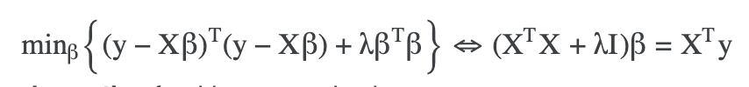
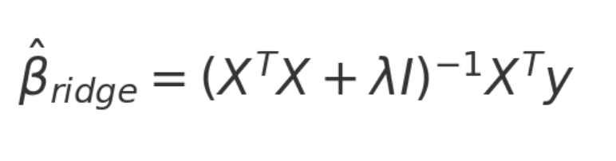
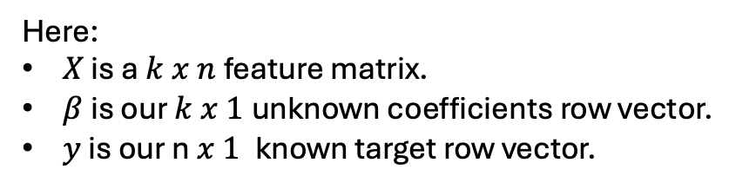
Ridge Regression
Here:
$X$ is a $k x n$feature matrix.
$β$is our $k x 1$unknown coefficients row vector.
$y$ is our n$x 1$known target row vector.

Slide 8
Benefits and Drawbacks of Ridge Regression
Benefits:
Addresses Multicollinearity: Shrinks correlated predictor coefficients, leading to more stable estimates.
Reduces Overfitting: Prevents fitting noise in training data, improving generalization.
Controls Large Coefficients: Penalizes large coefficients, reducing sensitivity to outliers.
Effective in High Dimensions: Works well with many predictors, even when highly correlated.
Smooths Model Complexity: Balances fitting and simplicity for more interpretable models.
Drawbacks:
Bias Introduction: Shrinks coefficients, introducing bias which can hurt accuracy if not needed.
No Feature Selection: Does not set coefficients to zero, keeping all predictors in the model.
Requires Tuning: λ needs careful tuning, increasing model complexity.
Less Interpretability: Shrunk coefficients make it harder to interpret predictor importance.
Ineffective Without Multicollinearity: Adds unnecessary bias when multicollinearity isn't present.

Slide 9

Code Demonstration on California Housing Dataset

